Slide 1
計中工讀生面試報告
ELK Stack安裝(Ubuntu)
匯入各種資料(sample: juniper, netflow ; apple股價)
自由發揮(Wireshark, Ubuntu syslog)
參考資料
B05901091 電機二 張凱為

Slide 2
ELK Stack安裝(Ubuntu)

Slide 3
ELK Stack安裝 (Ubuntu)
安裝JAVA
安裝elasticsearch
安裝logstash
安裝kibana
(安裝cerebro)

Slide 4
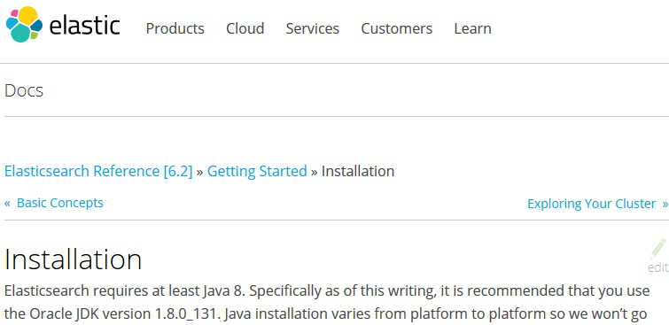
安裝JAVA
“Elasticsearch requires at least Java 8. Specifically as of this writing, it is recommended that you use the Oracle JDK version 1.8.0_131”

Slide 5
sudo apt-get install default-jdk
java –version
參考資料:
1.https://www.elastic.co/guide/en/elasticsearch/reference/current/_installation.html#_installation_example_with_tar
2.https://blog.gtwang.org/linux/how-to-install-java-with-apt-get-on-ubuntu-linux/

Slide 6
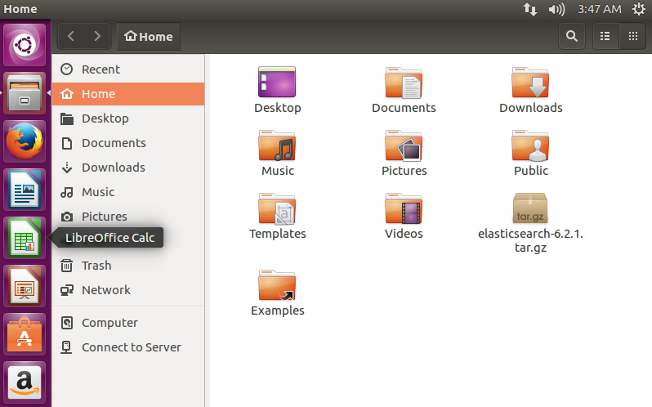
安裝elasticsearch(installation with tar)
1.安裝curl : sudo apt-get install curl
2. curl -O https://artifacts.elastic.co/downloads/elasticsearch/elasticsearch-6.2.1.tar.gz

Slide 7
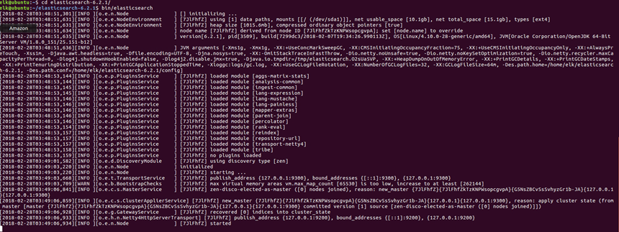
3.解壓縮 tar -zxvf elasticsearch-6.2.1.tar.gz
4.運行
cd elasticsearch-6.2.1
bin/elasticsearch

Slide 8
問題:記憶體問題
“There is insufficient memory for the Java Runtime Environment to continue.”

Slide 9
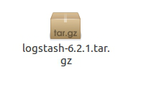
安裝logstash
下載檔案
curl –O https://artifacts.elastic.co/downloads/logstash/logstash-6.2.1.tar.gz

Slide 10
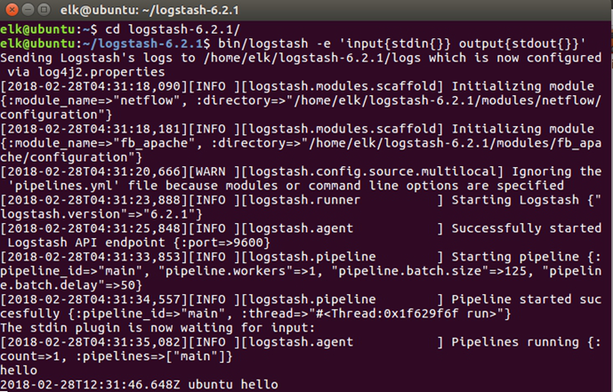
運行(測試):
cd logstash-6.2.1/
bin/logstash –e ‘input { stdin { } } output{ stdout { } }’

Slide 11
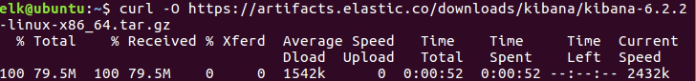
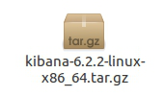
安裝kibana
curl –O https://artifacts.elastic.co/downloads/logstash/logstash-6.2.2.tar.gz

Slide 12
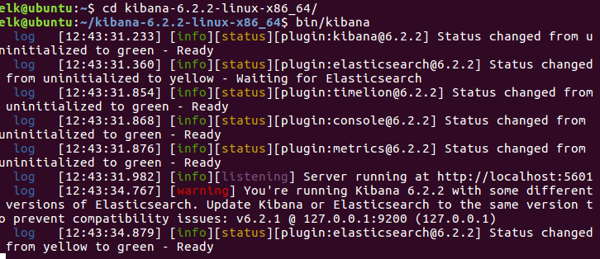
版本問題

Slide 13
版本確認
Elasticsearch:
Kibana:
Logstash:

Slide 14
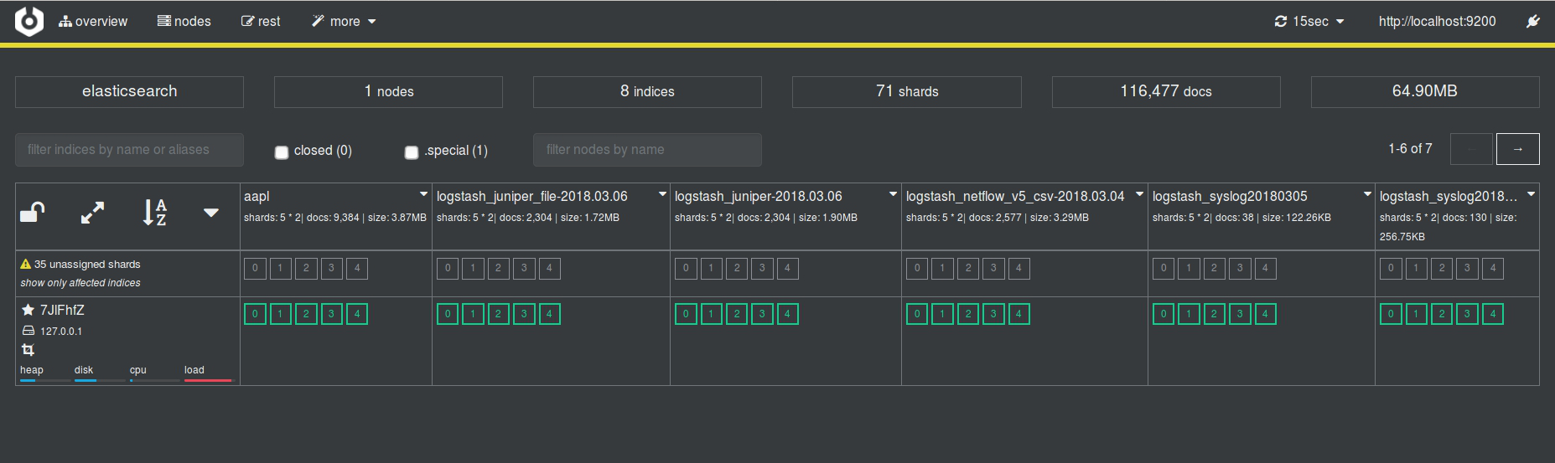
安裝cerebro

Slide 15
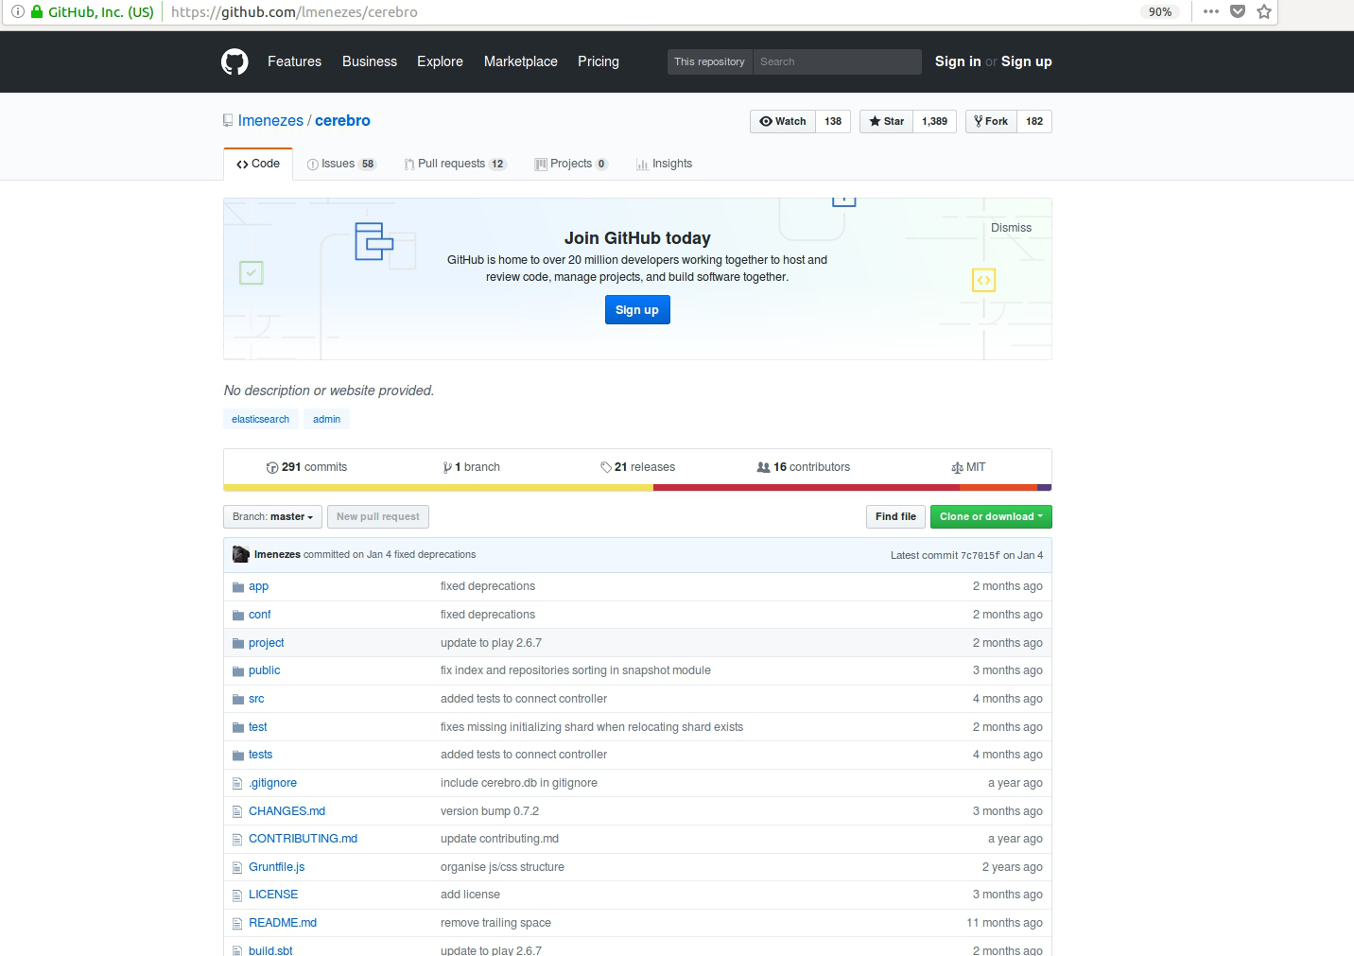

Slide 16
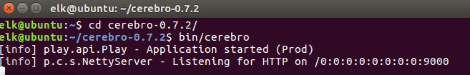
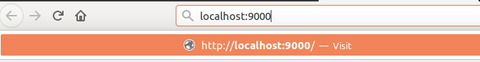

Slide 17
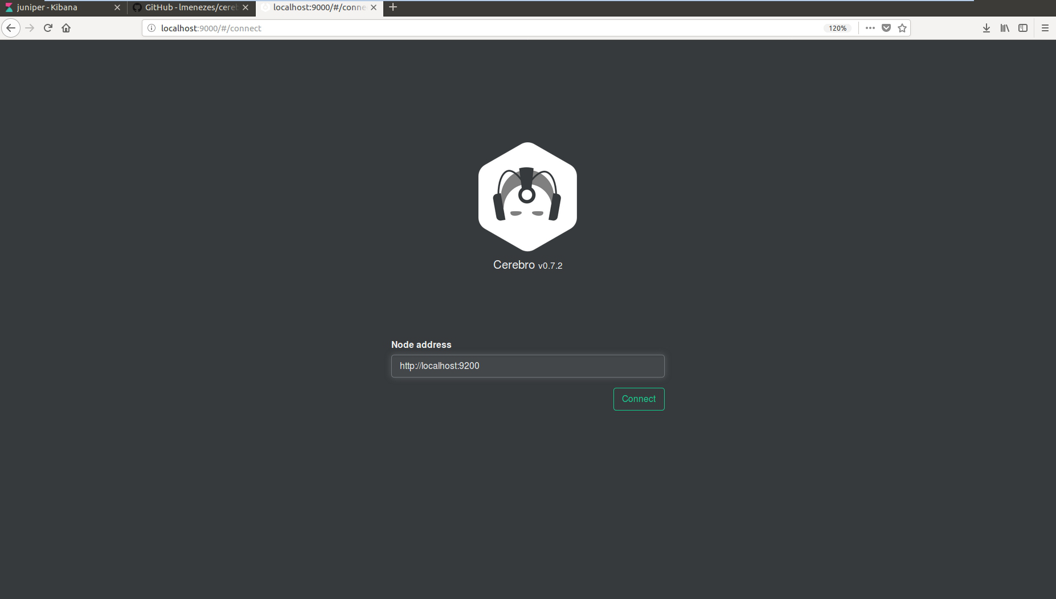

Slide 18
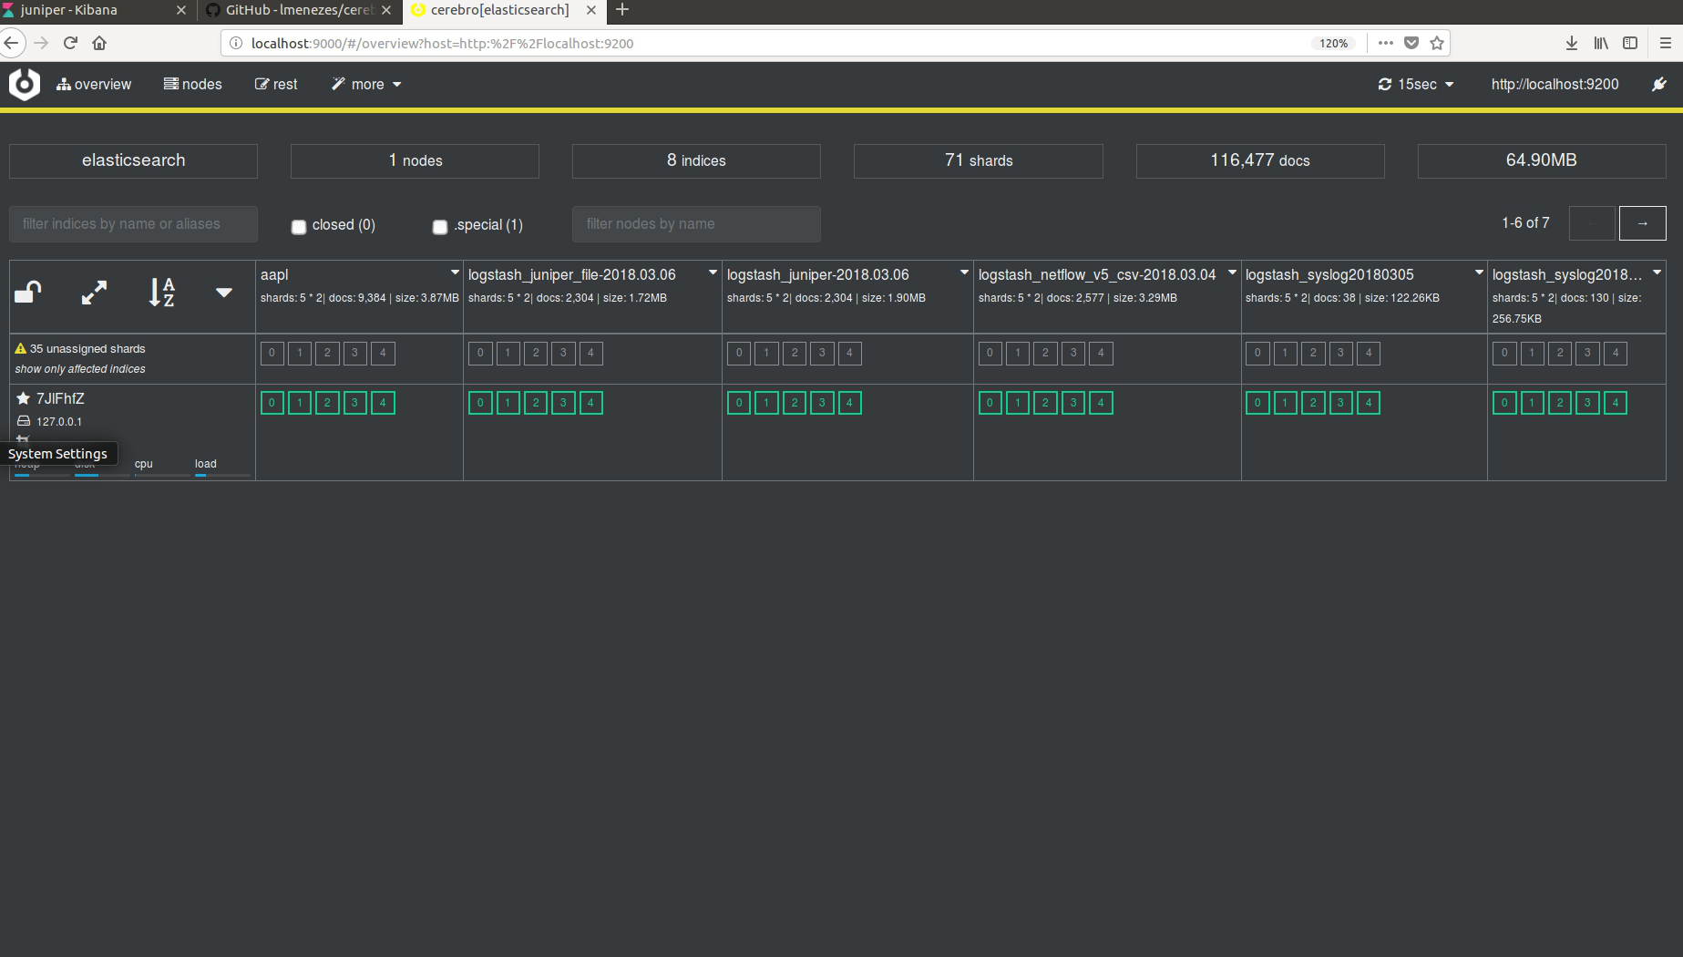

Slide 19
匯入各種資料

Slide 20
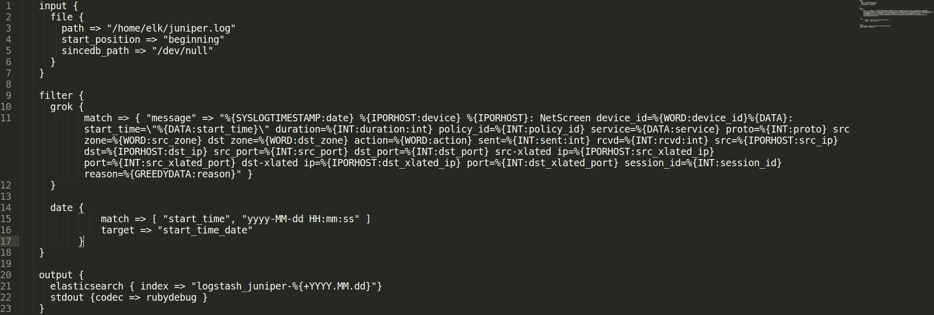
匯入資料(sample:juniper)

Slide 21
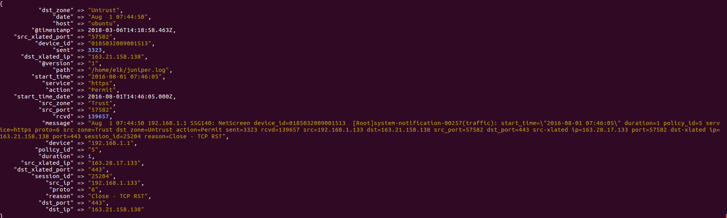

Slide 22
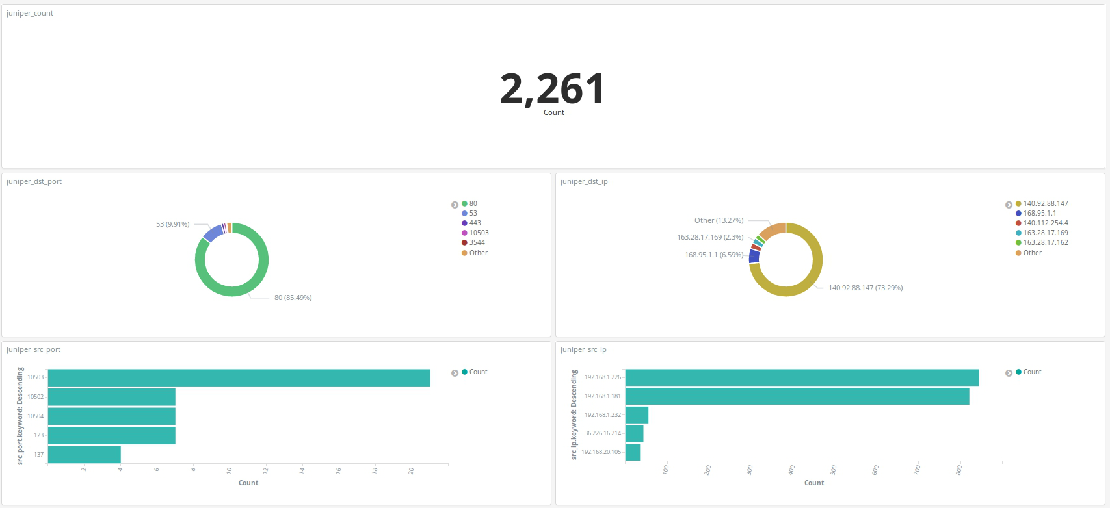
Juniper: kibana視覺化

Slide 23
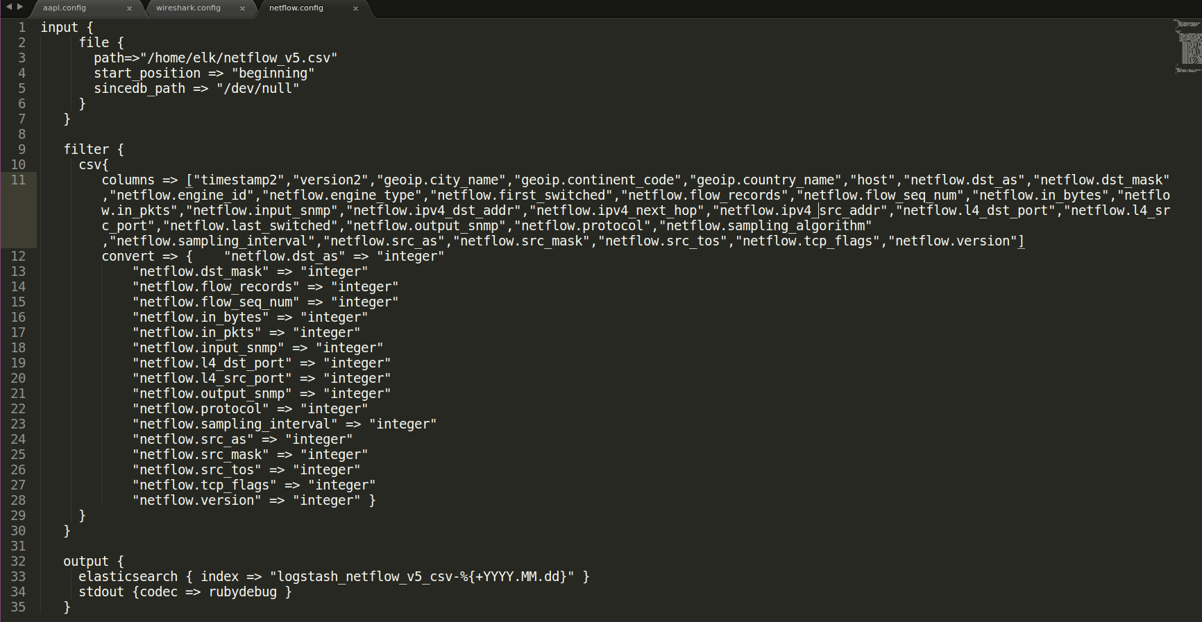
匯入資料(sample:netflow)

Slide 24
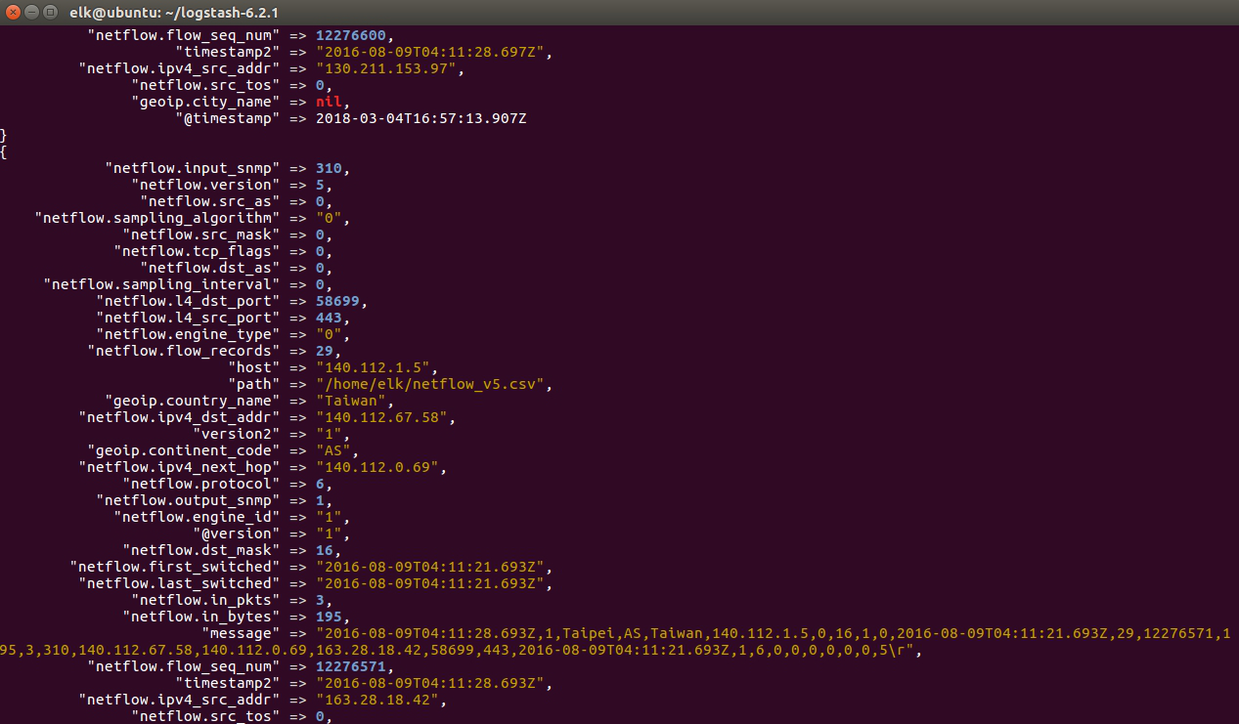

Slide 25
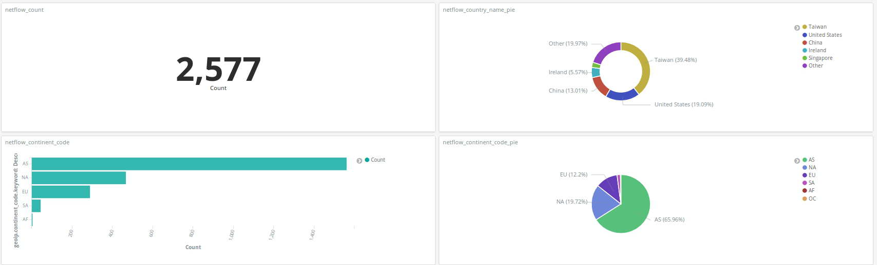
Netflow: kibana視覺化
資料筆數、country name、continent

Slide 26
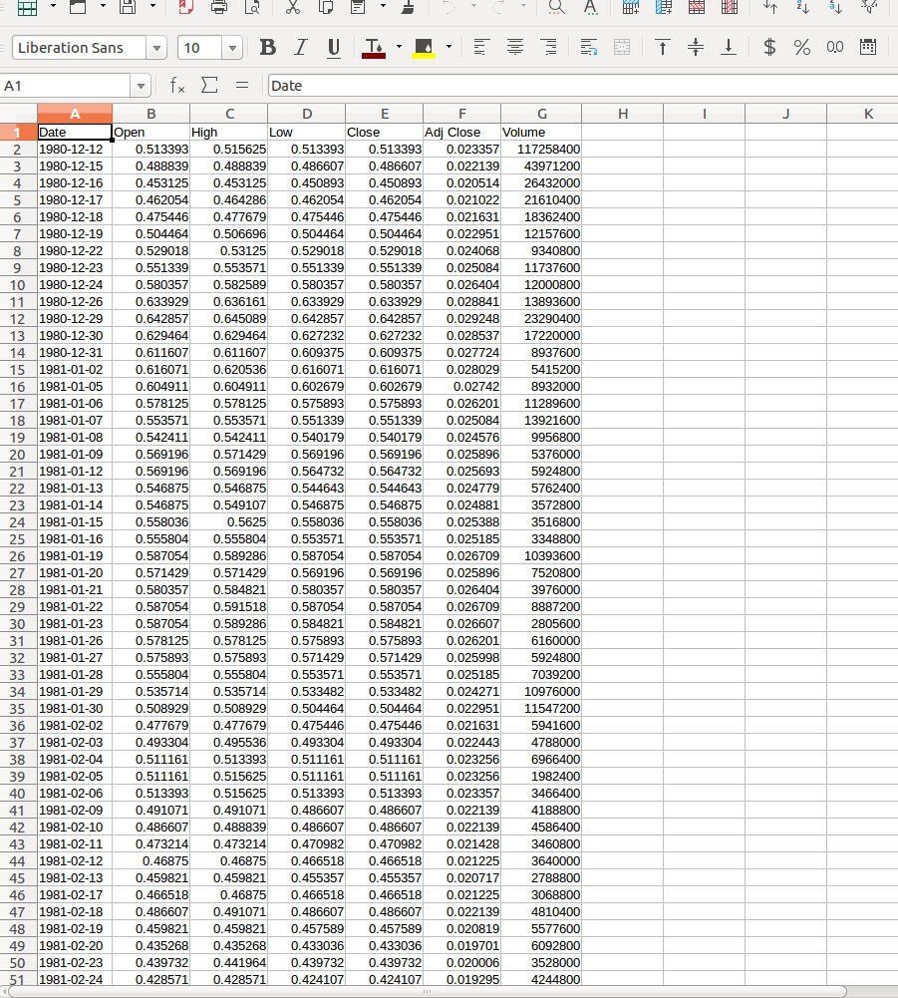
匯入資料(Apple 股票歷史資料)

Slide 27
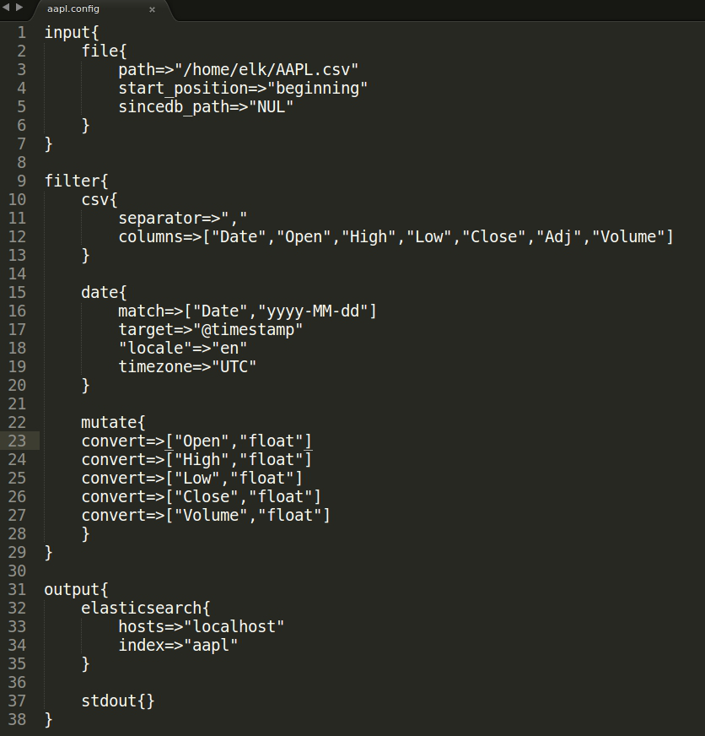
aapl.config

Slide 28
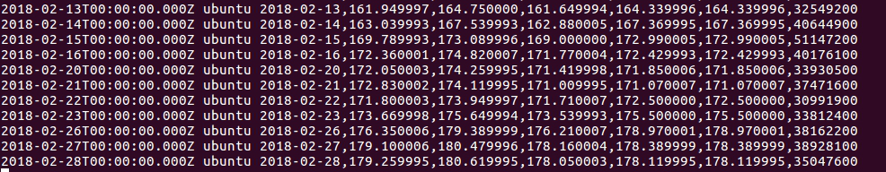

Slide 29
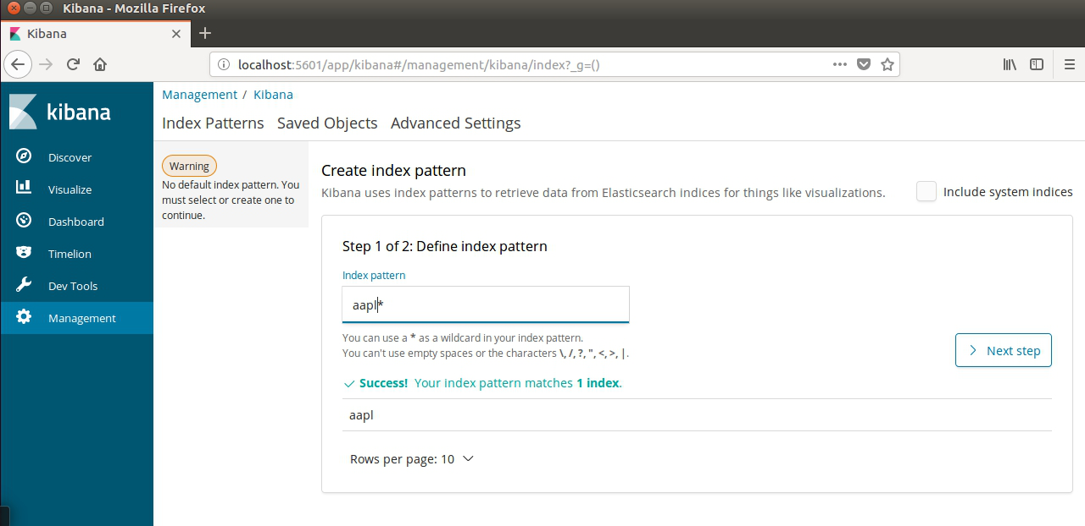
Index pattern

Slide 30
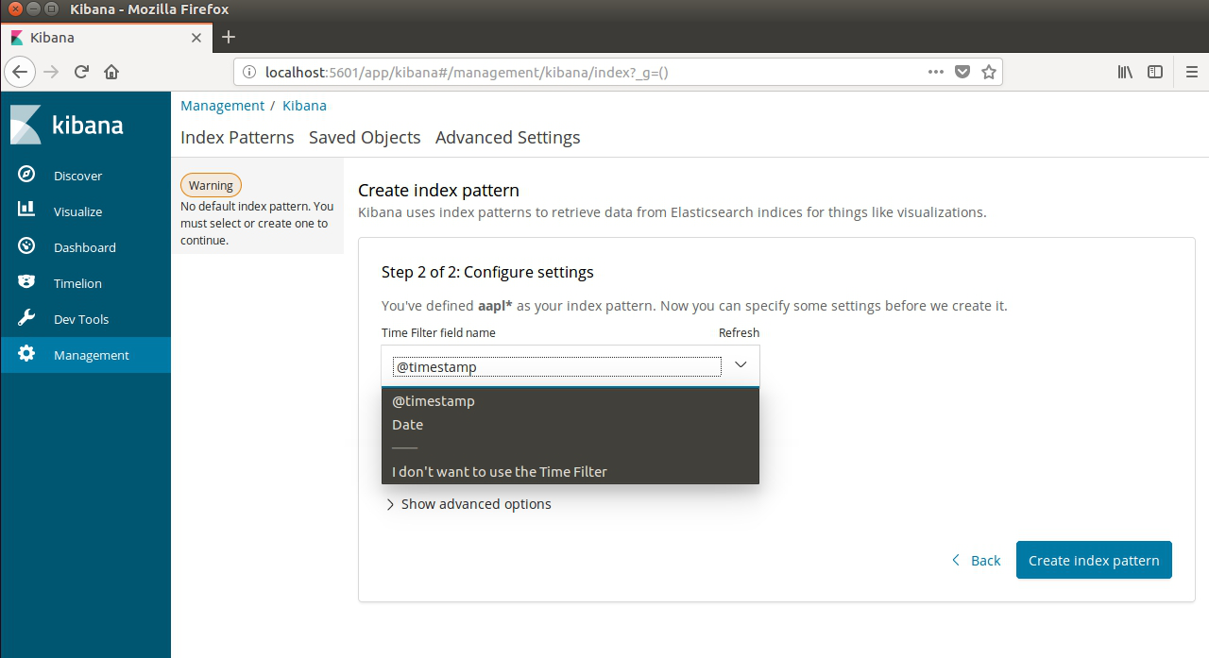

Slide 31
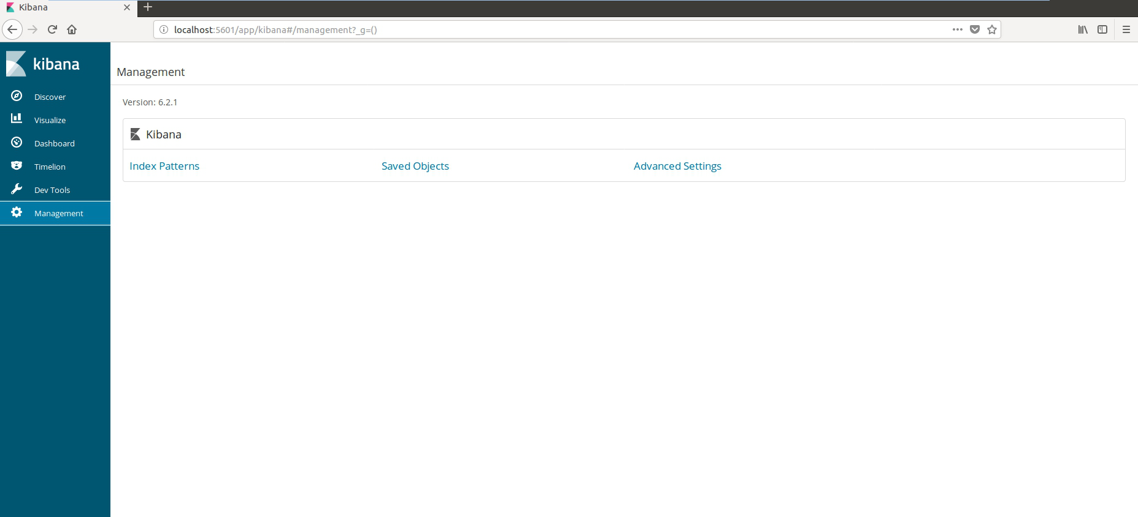
Kibana時區設定

Slide 32
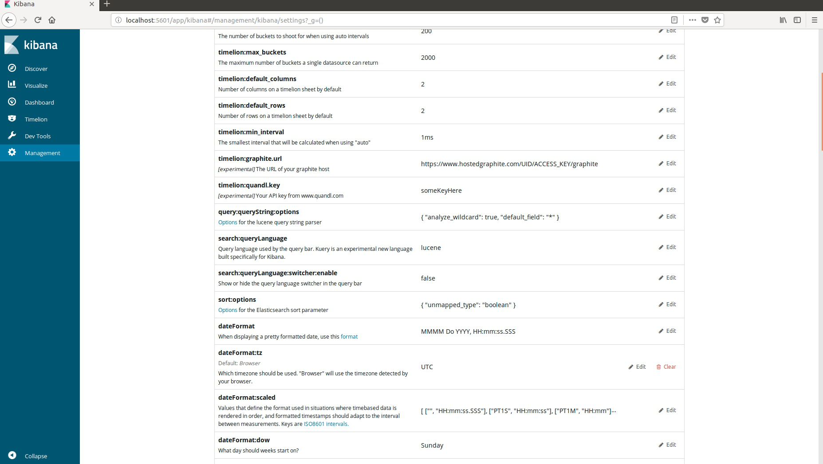

Slide 33
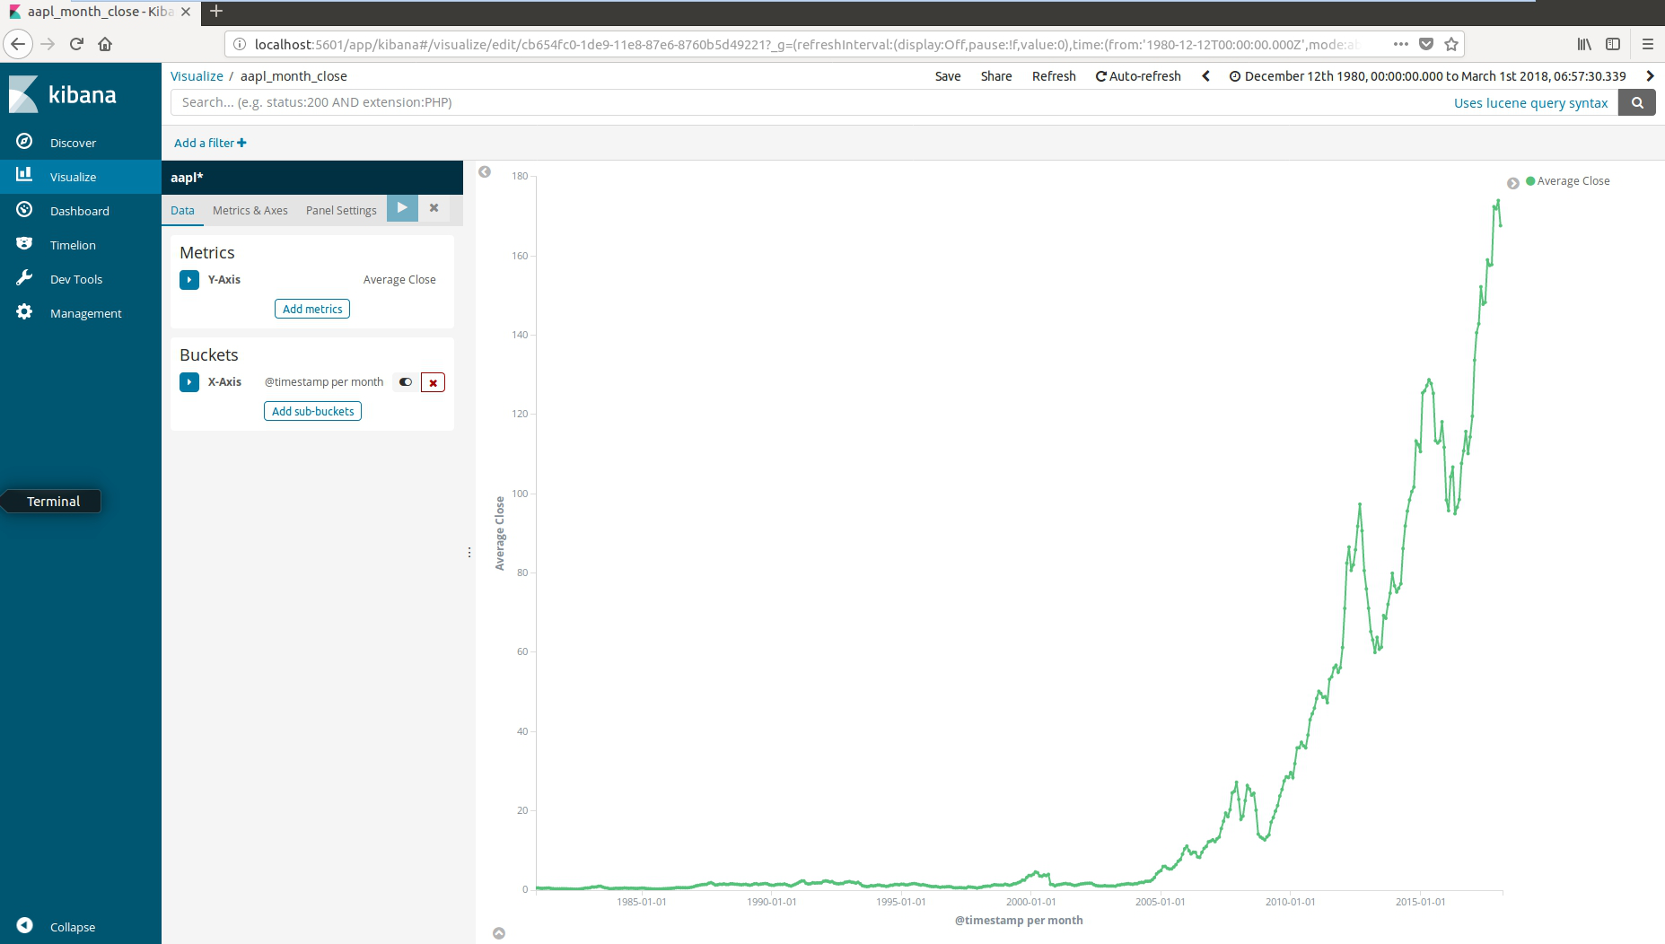
aapl每月平均收盤價(1980/12/12 ~)

Slide 34
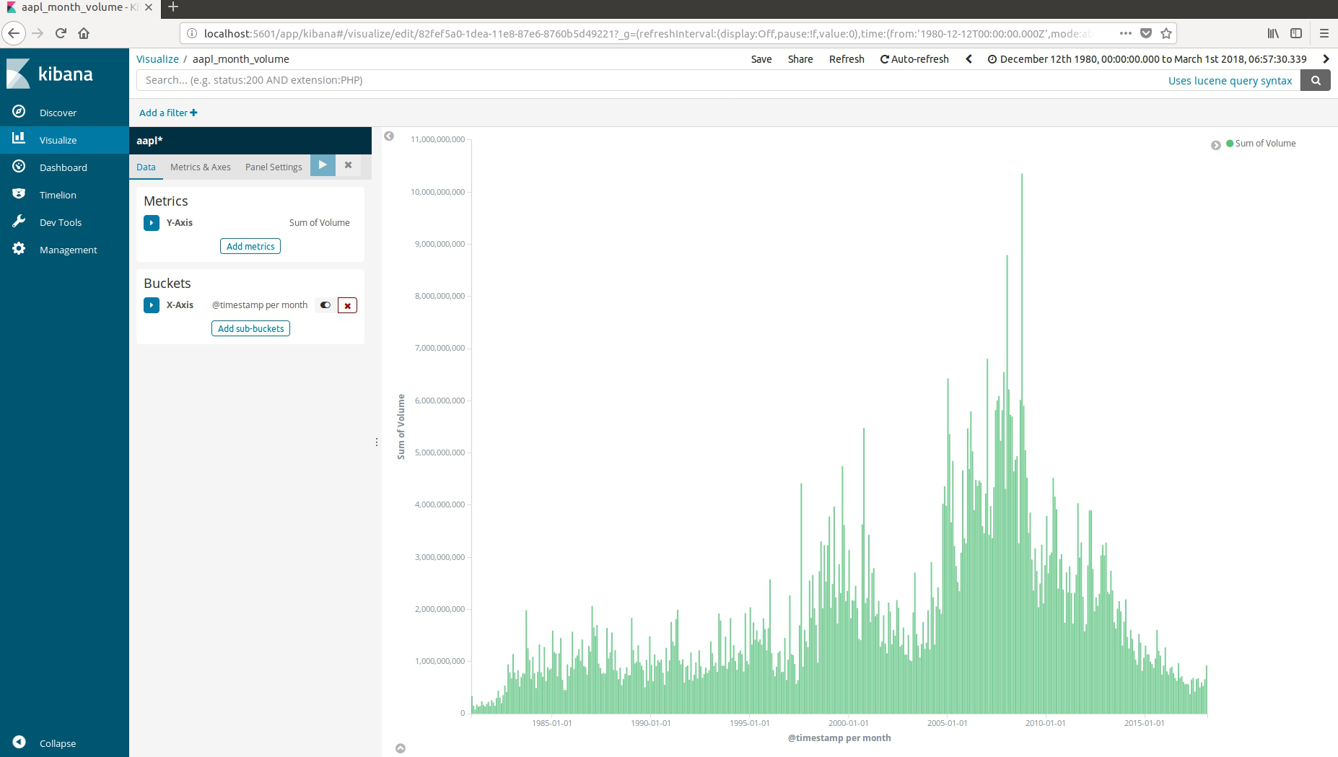
aapl每月總成交量(1980/12/12~)

Slide 35
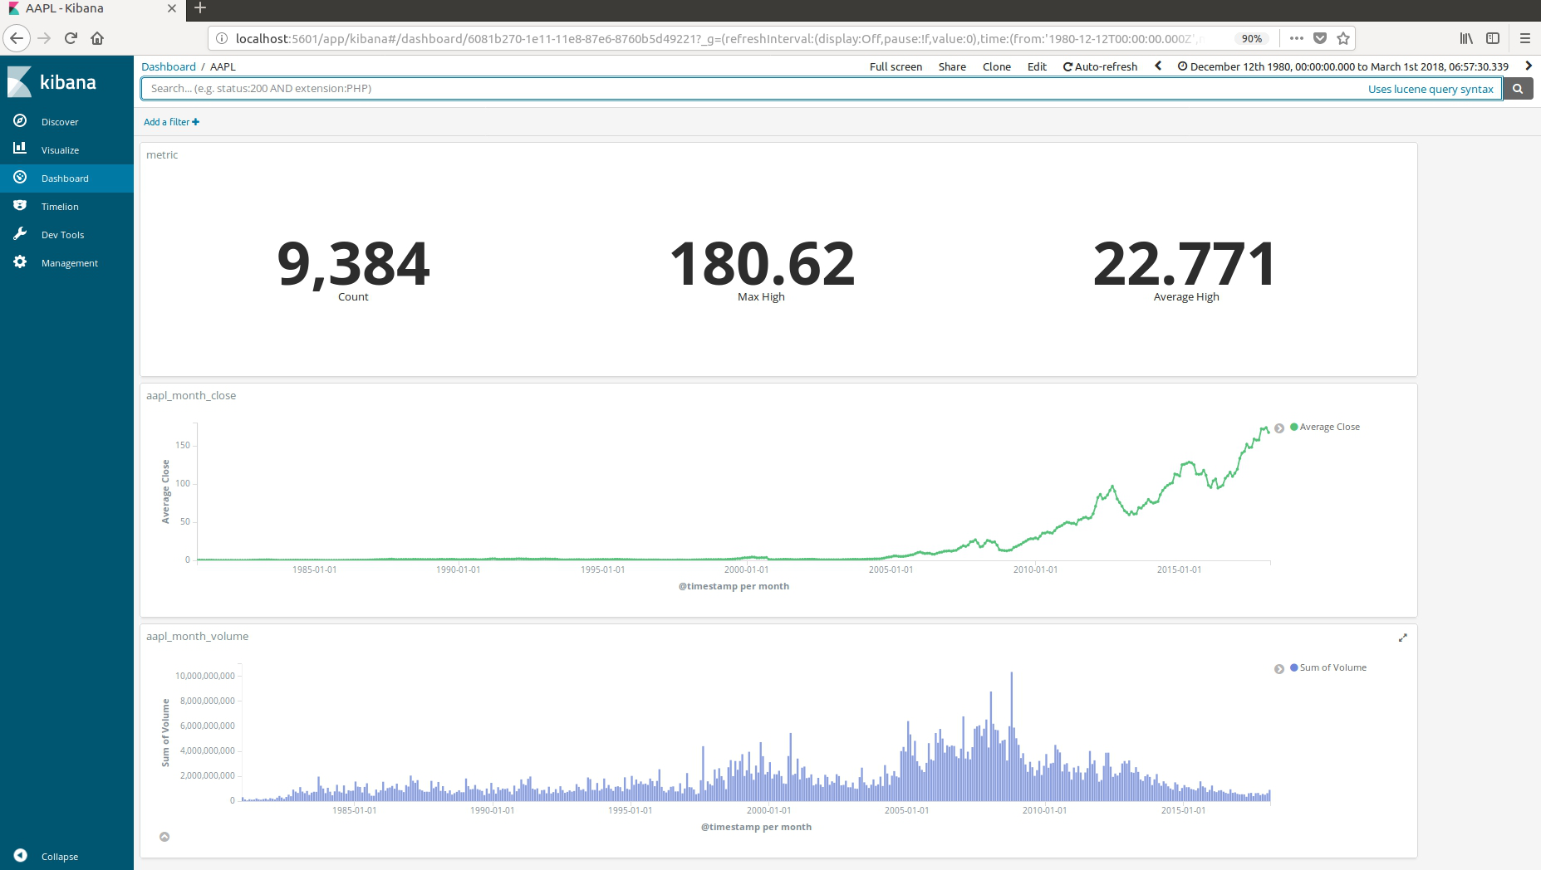
將圖表加入Dashboard(1980/12/12~)

Slide 36
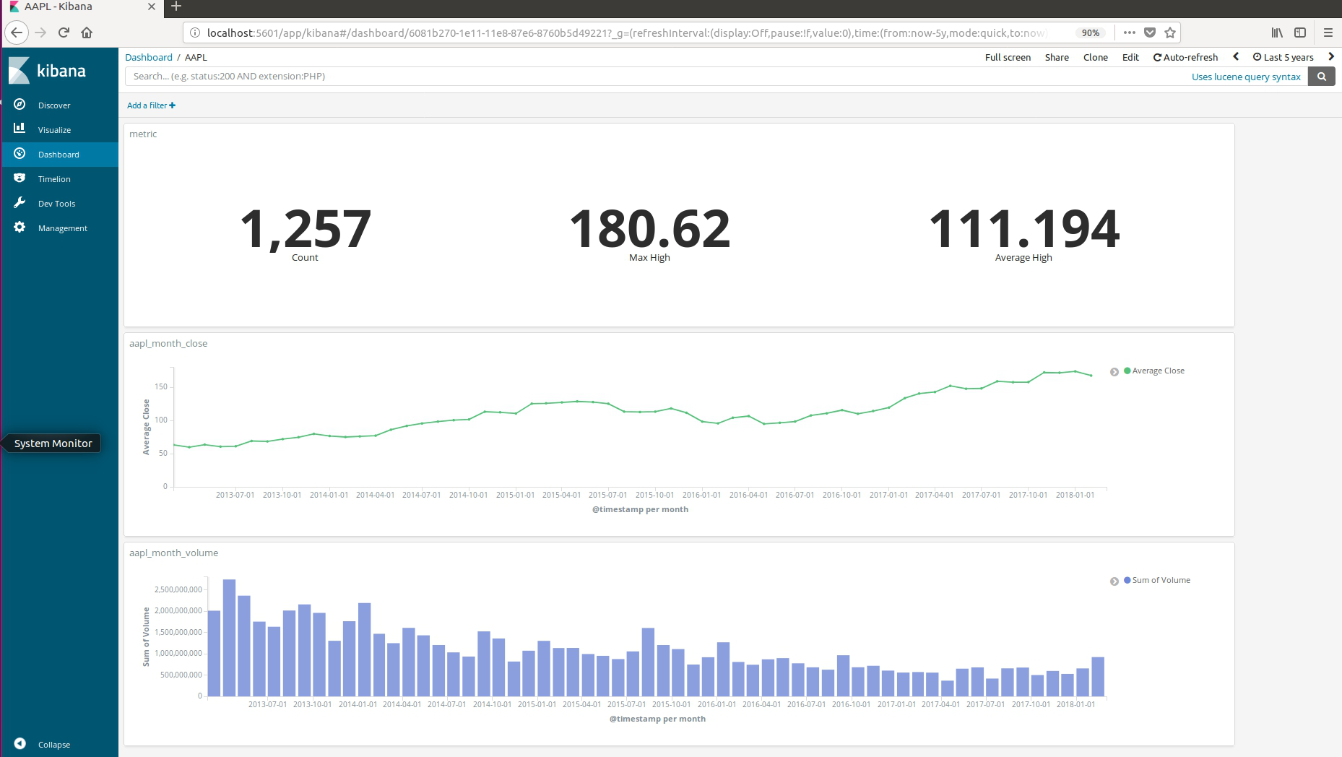
Dashboard (Last 5 years)

Slide 37
自由發揮

Slide 38
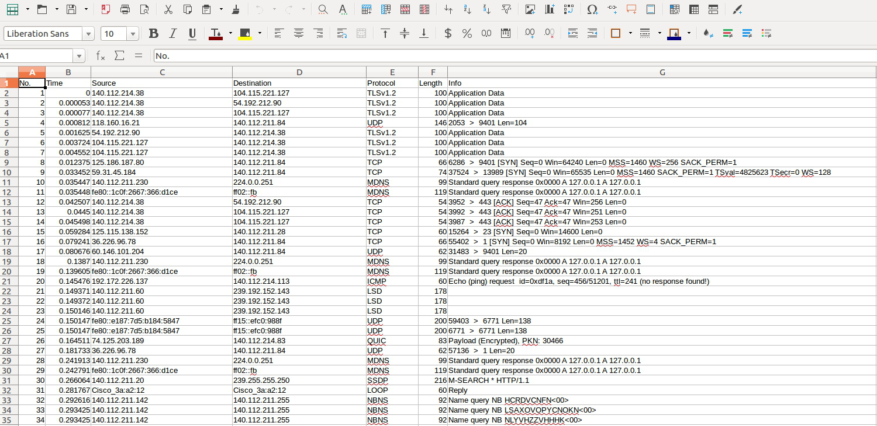
Wireshark

Slide 39
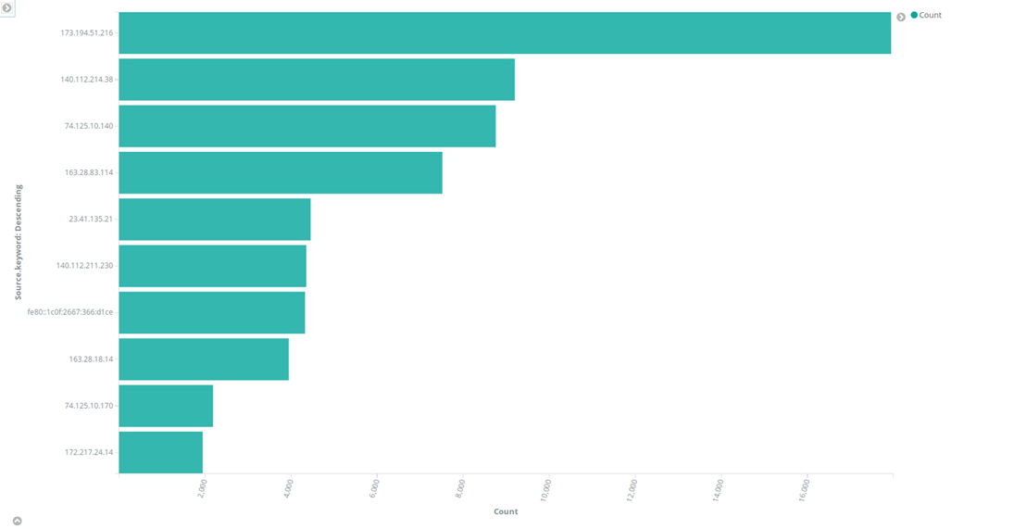
Top10 source ip bar chart

Slide 40
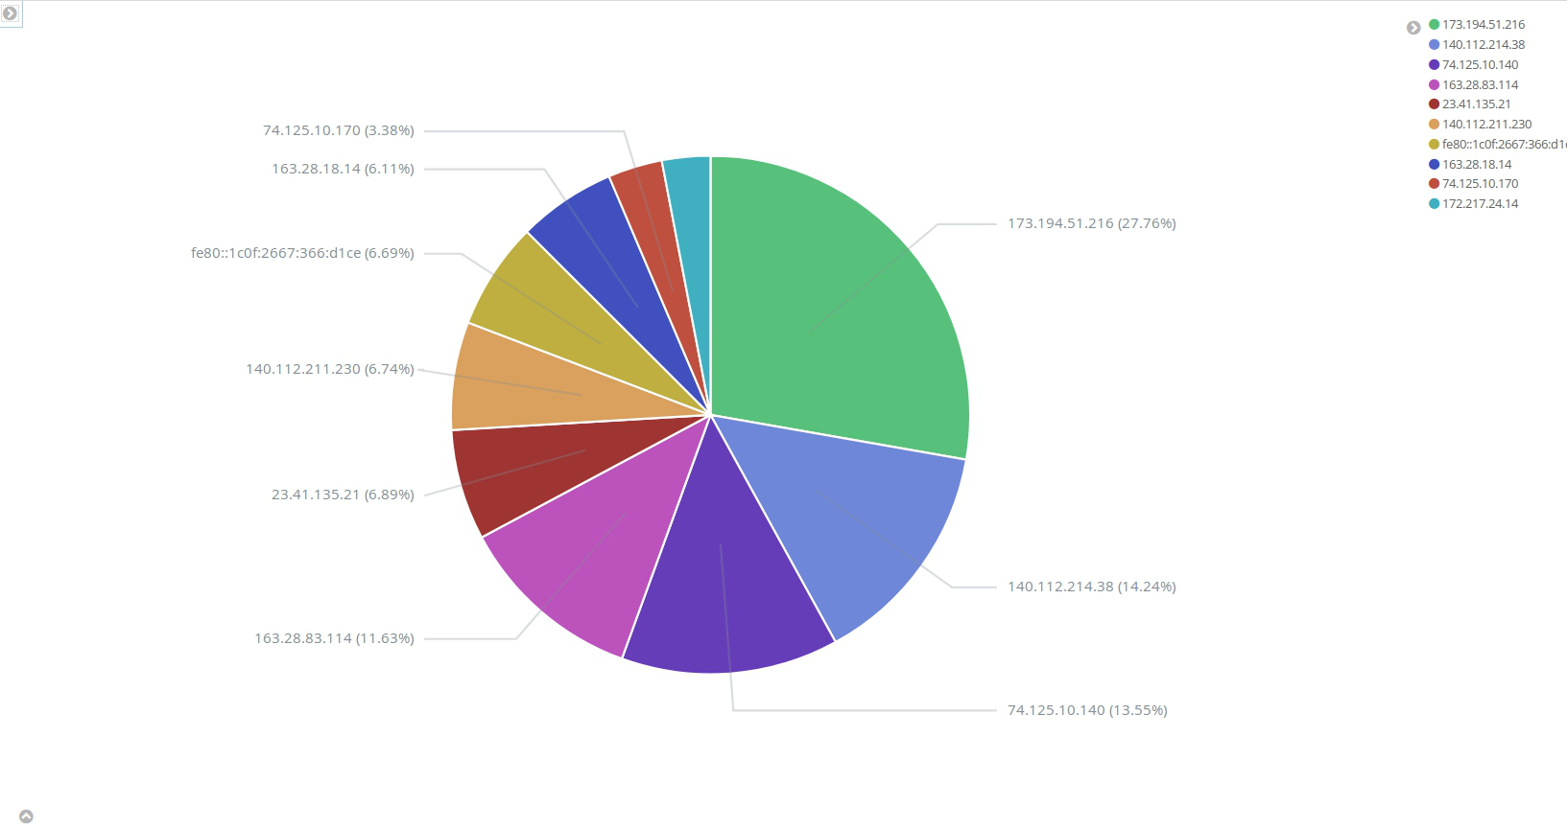
Top10 source ip pie chart

Slide 41
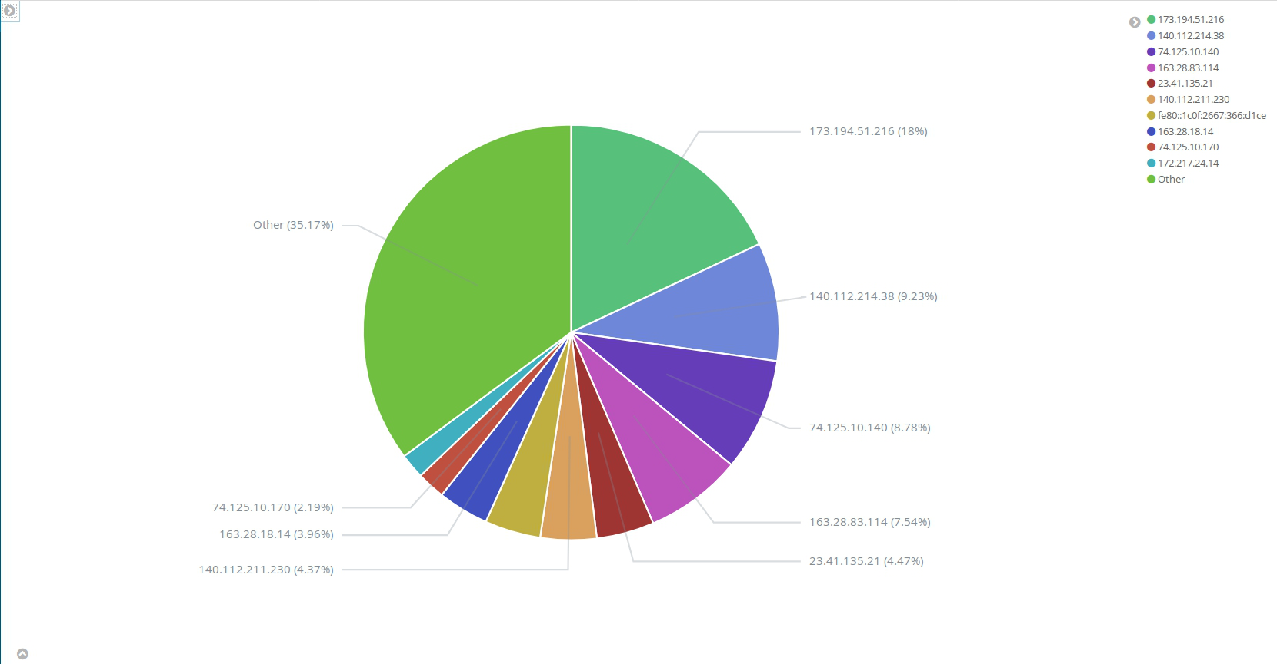
Top10 source ip pie chart(with “other”)

Slide 42
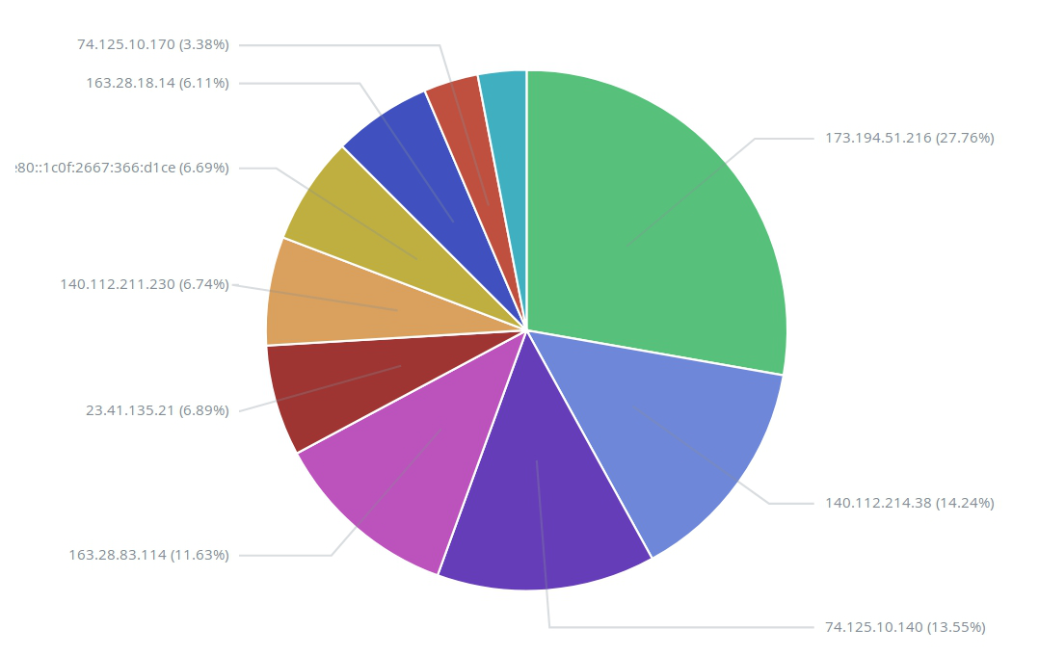
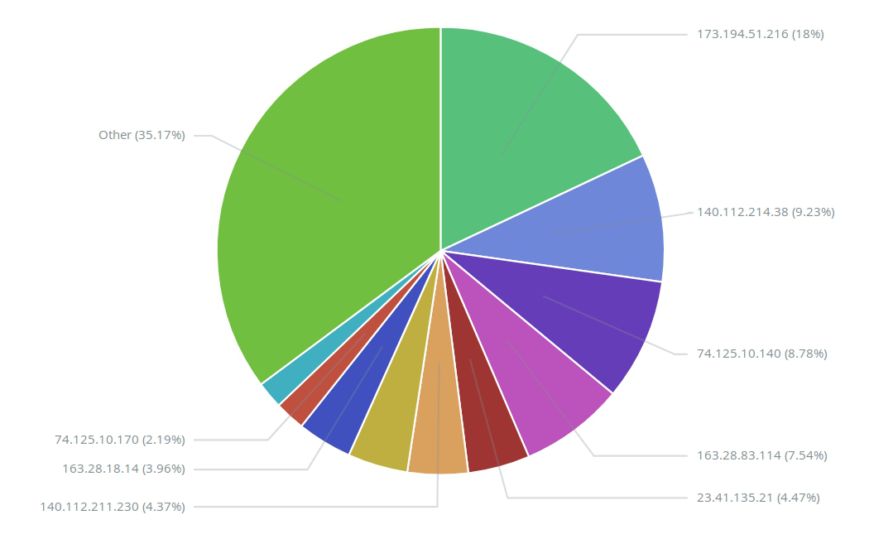
不包含other:
包含other:

Slide 43
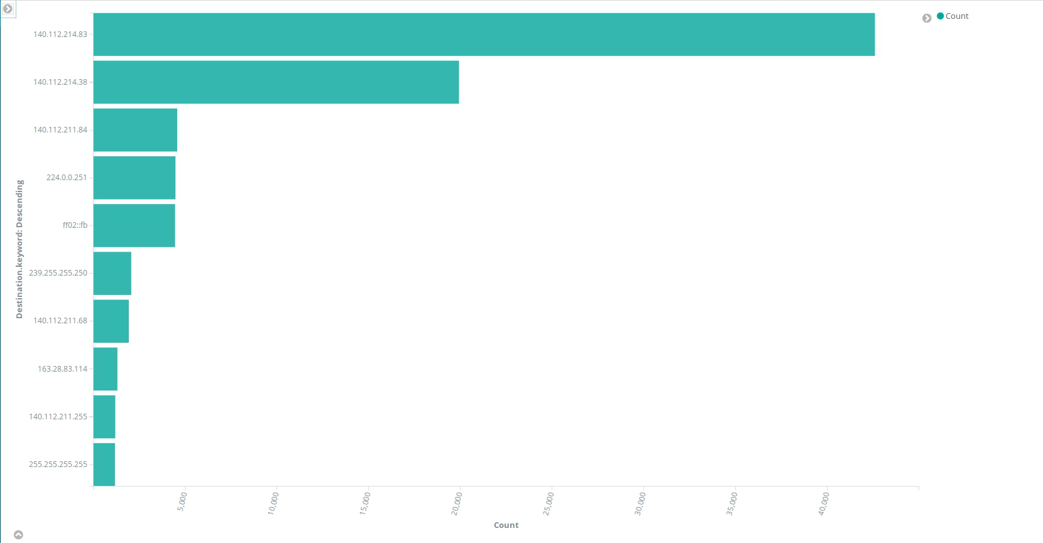
Top10 source ip bar chart

Slide 44
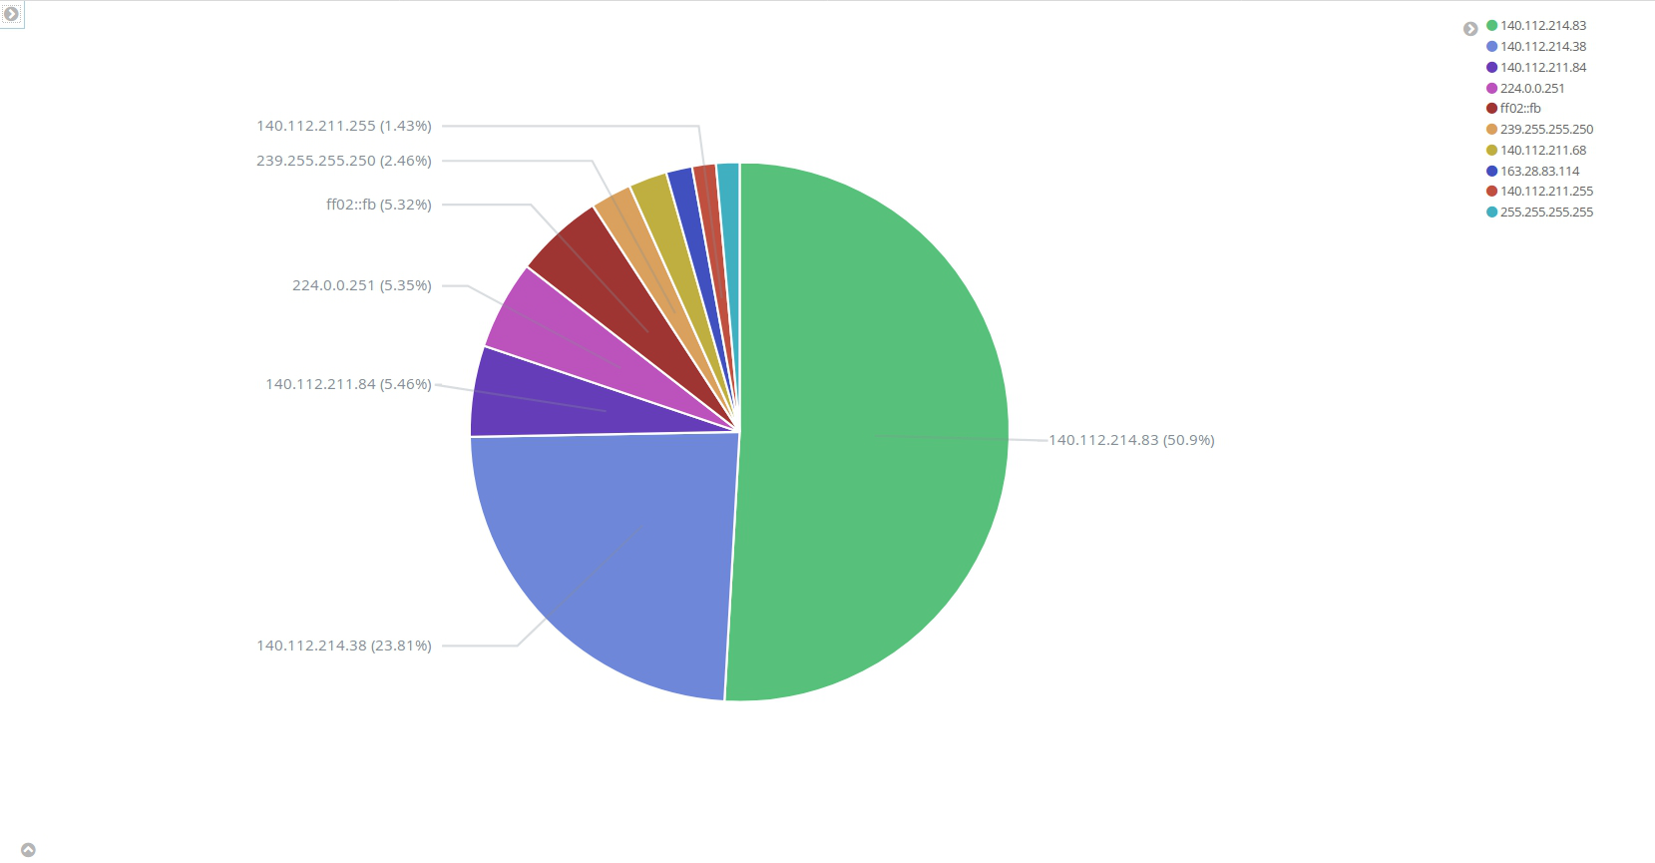
Top10 destination ip pie chart

Slide 45
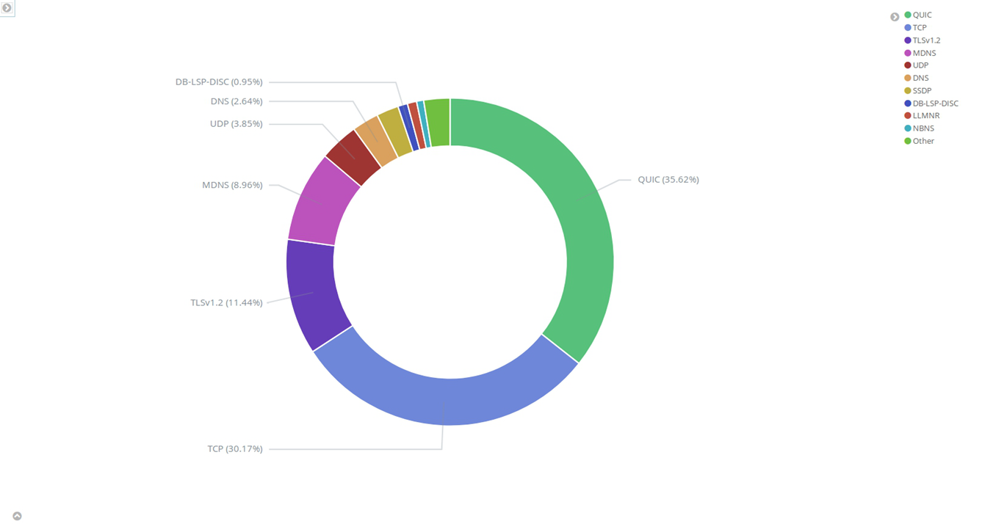
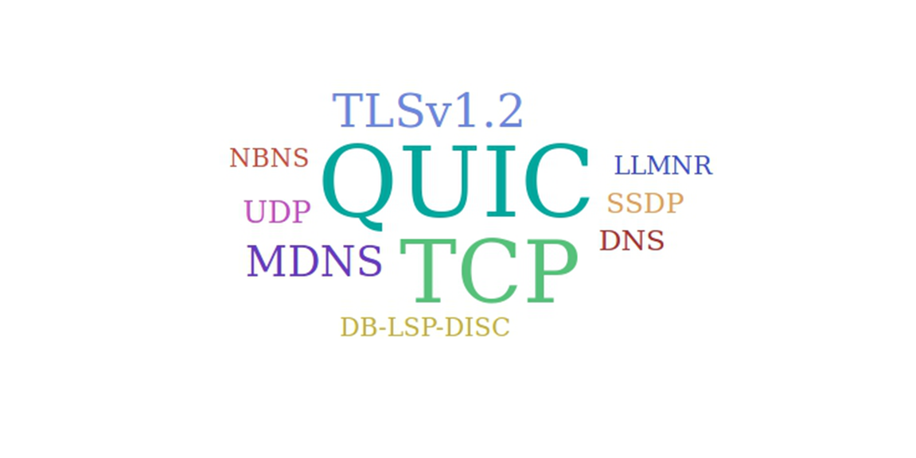
Top10 Protocol pie chart, tag cloud

Slide 46
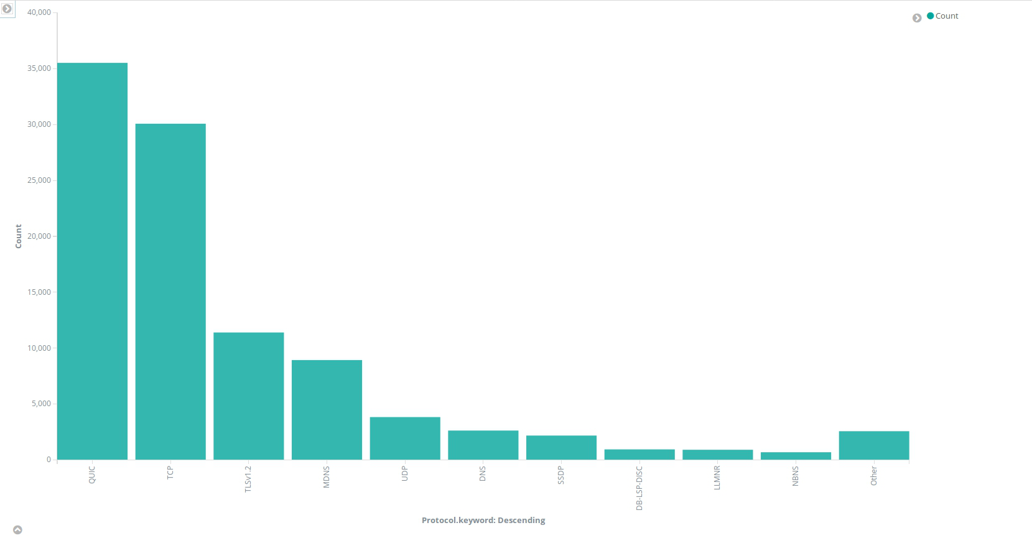
Vertical bar chart

Slide 47
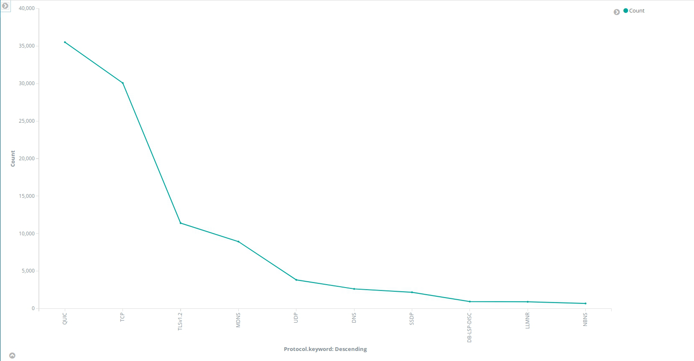
Line chart

Slide 48
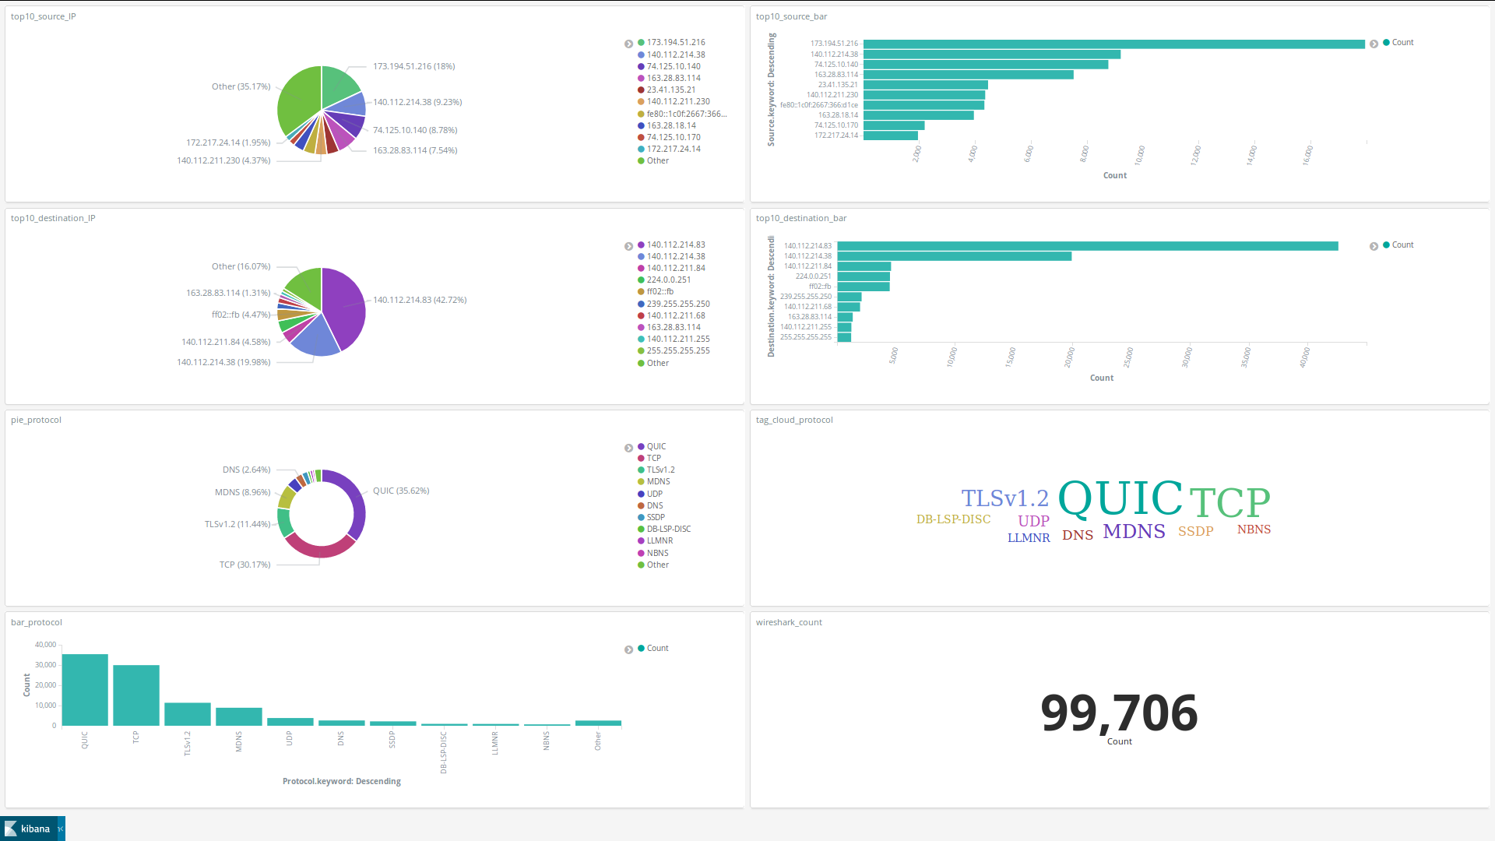
Wireshark_dashboard

Slide 49
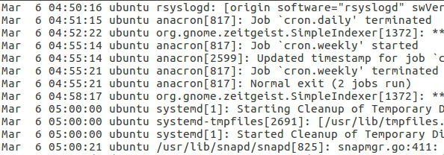
Ubuntu syslog

Slide 50
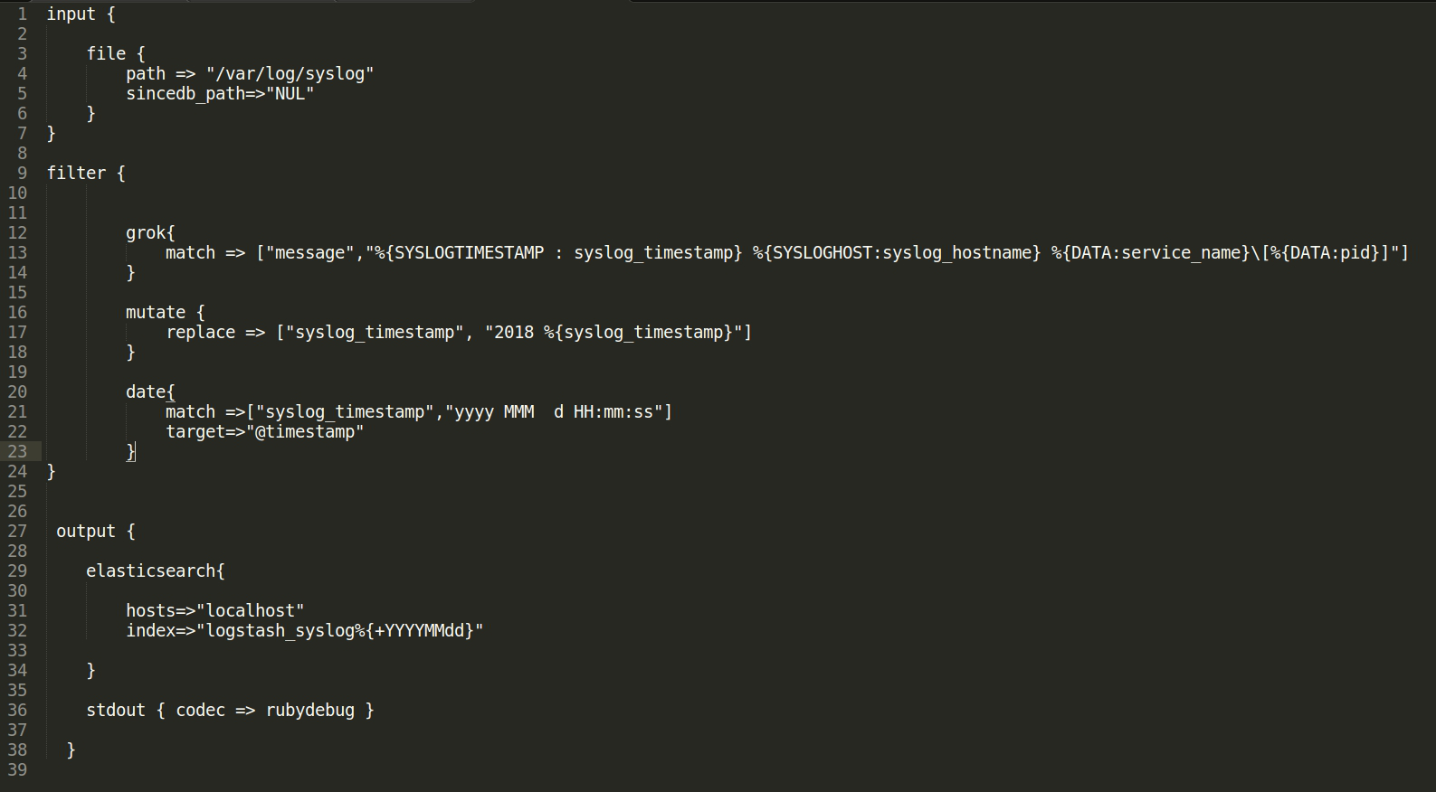
Config file

Slide 51
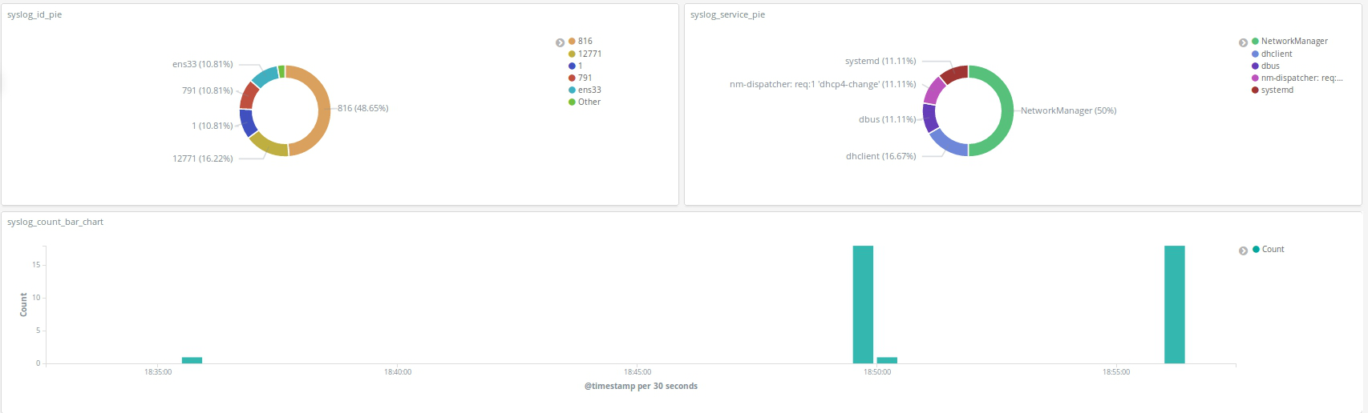

Slide 52
參考資料
官方reference:
https://www.elastic.co/guide/en/elasticsearch/reference/current/index.html
https://www.elastic.co/guide/en/kibana/current/introduction.html
https://www.elastic.co/guide/en/logstash/6.1/index.html
grok語法, pattern, debugger:
https://blog.johnwu.cc/article/elk-logstash-grok-filter.html
https://github.com/logstash-plugins/logstash-patterns-core/blob/master/patterns/grok-patterns
https://grokdebug.herokuapp.com/
“Learning ELK Stack”

Slide 53
感謝聆聽

